Slide 1
ER to Relational Mapping

Slide 2
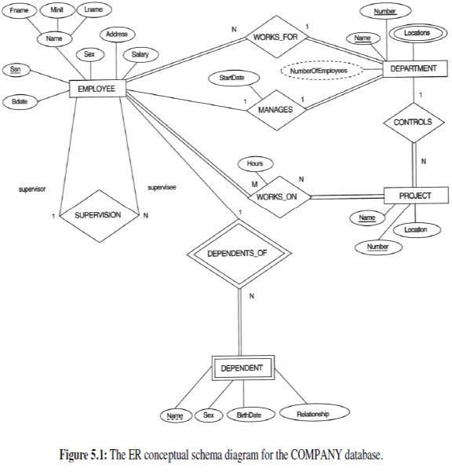
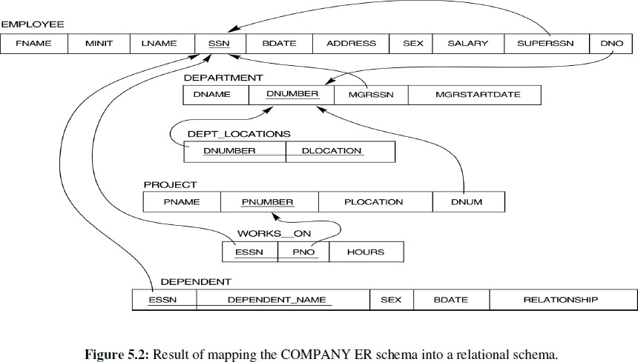
Mapping from ER to Relational Model
Data Model Mapping refers to the process of converting Entity-relationship schema to Relational schema which can directly be implemented by any Relational database management system (DBMS) like Oracle, MySQL etc.

Slide 3
ER to Relational Mapping Algorithm
To convert an Entity-Relationship model to a relational database schema, a procedure of seven steps should be followed:
Step 1: Mapping of Regular Entity Sets. Step 2: Mapping of Weak Entity Sets
Step 3: Mapping of Binary 1:1 Relationship Sets Step 4: Mapping of Binary 1:N Relationship Sets. Step 5: Mapping of Binary M:N Relationship Sets. Step 6: Mapping of N-ary Relationship Sets.

Slide 4
Step 1: Mapping of Regular Entity Sets
For each regular entity type in the ER diagram, create a relation.
Simple attributes are represented as fields; however:
multi-valued attributes represented as a relation (It’s the attribute which takes up more than a single value for each entity e.g. Phone number of a student: Landline and mobile). One common way to handle multivalued attributes: creating separate tables: for Student table with a multivalued attribute 'Phone Numbers', we can create a separate 'Phone Numbers' table. This table would have two columns: Stu_ID' and 'Ph_No'.
derived attributes are not usually stored
composite attributes are usually split into several fields
Choose one of the key attributes of entity type as the primary key for the relation.
If the chosen key of entity type is composite, the set of simple attributes that form it will together form the primary key of the relation.

Slide 5
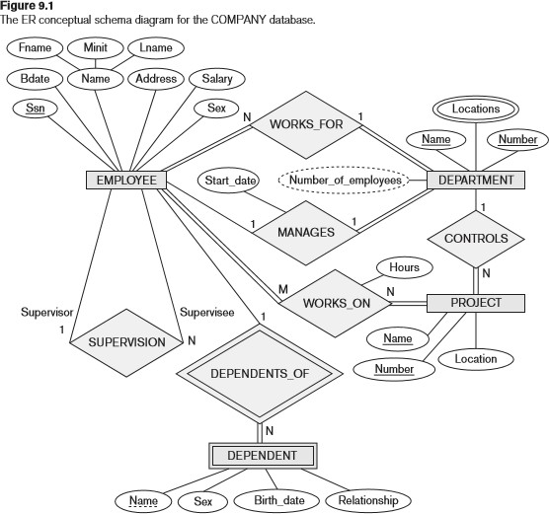
Example

Slide 6
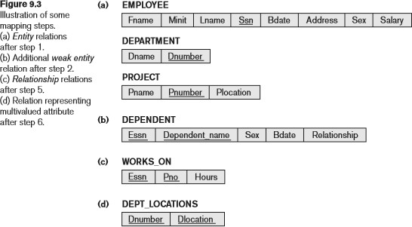
Example
We create the relations EMPLOYEE, DEPARTMENT, and PROJECT in the relational schema corresponding to the regular entities in the ER diagram. SSN, DNUMBER, and PNUMBER are the primary keys for the relations EMPLOYEE, DEPARTMENT, and PROJECT as shown.
Step 1 in fig 9.3 (a)

Slide 7
Step 2: Mapping of Weak Entity Sets
For each weak entity type, create a relation and include primary key attribute of strong entity as
foreign key attribute of the relation, and the partial key of the weak entity type, if any.

Slide 8
Example
Create the relation DEPENDENTto correspond to the weak entity type DEPENDENT. Include the primary key SSN of the EMPLOYEE relation as a foreign key attribute of DEPENDENT (renamed to ESSN).The primary key of the DEPENDENT relation is the combination {ESSN, DEPENDENT_NAME} because DEPENDENT_NAME is
the partial key of DEPENDENT.

Slide 9
Example
Step 2 represents in (b)

Slide 10
Step 3: Mapping of Binary 1:1 Relationship Sets
For each binary 1:1 relationship type in the ER schema there are two possible options:
- Add the primary key of Entity set 1 as a foreign key of Entity set 2
- Add the primary key of Entity set 2 as a foreign key of Entity set 1
- Efficient approach :Primary key on the mandatory side becomes a foreign key on the optional side

Slide 11
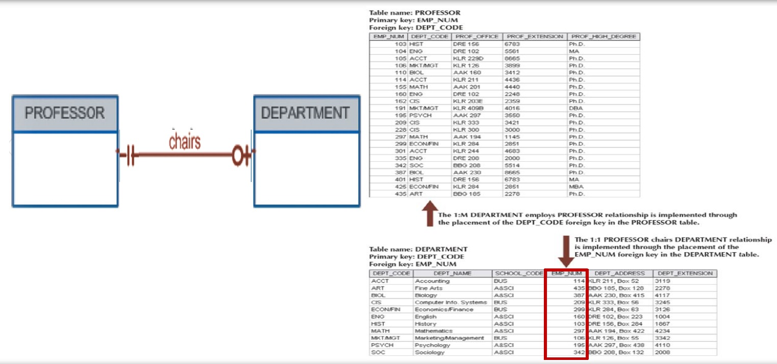
Example

Slide 12
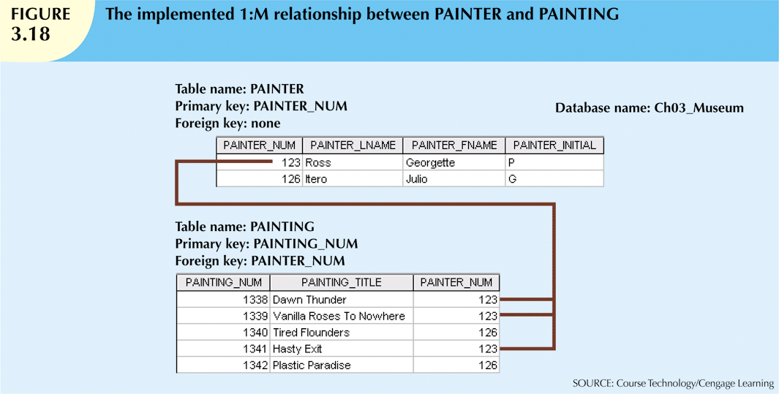

Step 4: Mapping of Binary 1:N Relationship Sets
– Add the Primary key attribute (or attributes) of the entity on the one side of the relationship as a Foreign key in the relation on the other (N) side
– The one side migrates to the many side

Slide 13
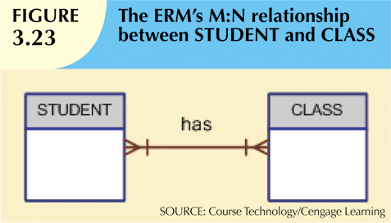
Step 5: Mapping of Binary M:N Relationship Sets
Implemented by breaking it up to produce a set of 1:M relationships. For each binary M:N relationship type:
Create a new relation.
Add primary key of participating entity types as foreign key attributes in the new relation.
Include any simple attributes of M:N relationship type.

Slide 14
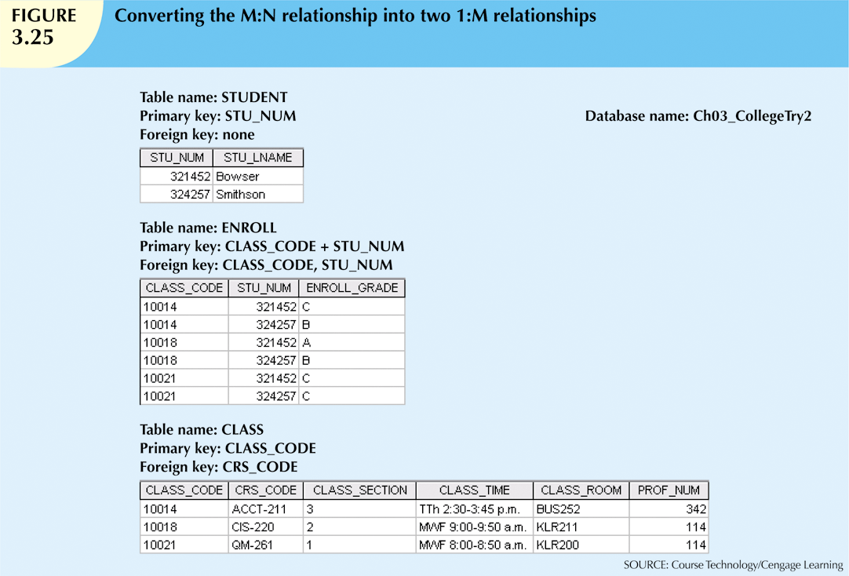
Example

Slide 15
Step 6: Mapping of N-ary Relationship Sets
For each n-ary relationship type
Create a new relation.
Made up of the primary keys from the n participating relations, as foreign keys.
plus any attributes of the relationship.

Slide 16
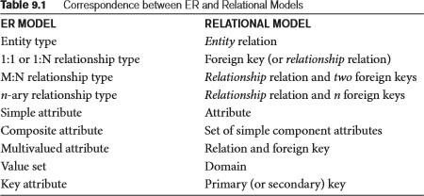
Summary of Mapping constructs and constraints

